Slide 1
Duplication Coloring Book

Slide 2
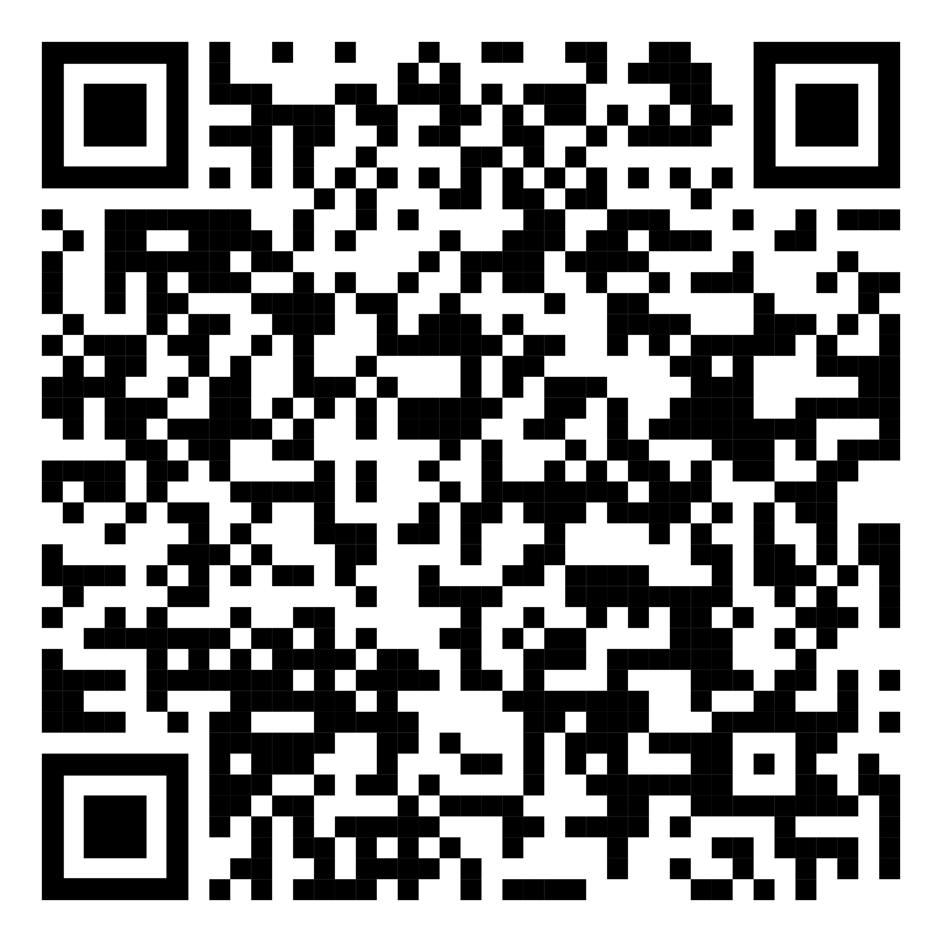
https://github.com/isidore/Talks/blob/master/DuplicationColoringBook.md#duplication-coloring-book

Slide 3
Thanks!
Any questions?
You can find me at:
@LlewellynFalco
info@spunlabs.com

